Slide 1
Closure of Relations

Slide 2
Closure
The closure of a relation R with respect to property P is the relation obtained by adding the minimum number of ordered pairs to R to obtain property P.
In other words, for a reflexive property P, add ( a, a) to the relation for each (a, a) missing in the relation.
In terms of the digraph representation of R
To find the reflexive closure - add loops.
To find the symmetric closure - add arcs in the opposite direction.
To find the transitive closure - if there is a path from a to b, add an arc from a to b.

Slide 3
Consider the set {1, 2, 3, 4}
The relation R = { (1, 3), (2, 2), (3, 3), (3, 4) }
The relation is not reflexive, because (1, 1) and ( 4, 4) are missing
How can we make it reflexive closure of R?
Solution. This can be done by adding (1, 1) and (4, 4) to R, because these are the only pairs of the form (a, a) that are not in R.
Thus reflexive closure of R is R^{r}= {(1, 3),(2, 2), (3,3),(3, 4),(1, 1),(4, 4)}.

Slide 4
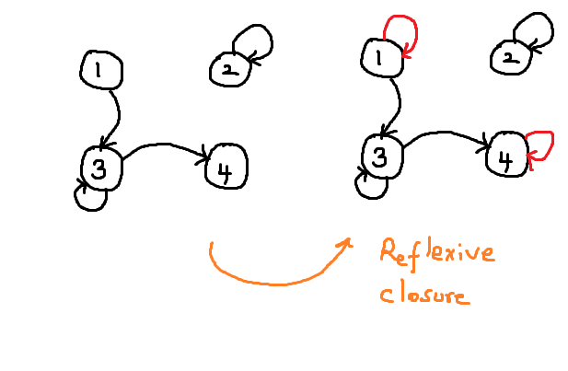
What this in digraph
Check each vertex.
If the loop is missing, add the loop.

Slide 5
Symmetric Closure
The symmetric closure of R is obtained by adding (b, a) to R for each (a, b) ∈ R.
Consider the set {1, 2, 3, 4}
The relation R = { (1, 3), (2, 2), (3, 3), (3, 4) }
This is not symmetric
How do we make it symmetric closure ?
we need to ( 3, 1) , (4, 3)

Slide 6
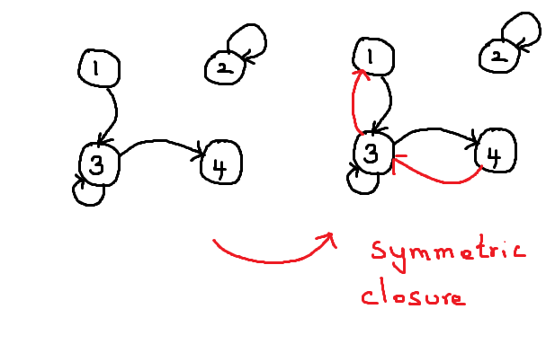

Slide 7
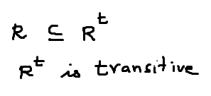
Transitive closure
Let A be a set
R is a relation on A.
The transitive closure of R is the relation R^{t} on A that satisfies the following three properties:

Slide 8
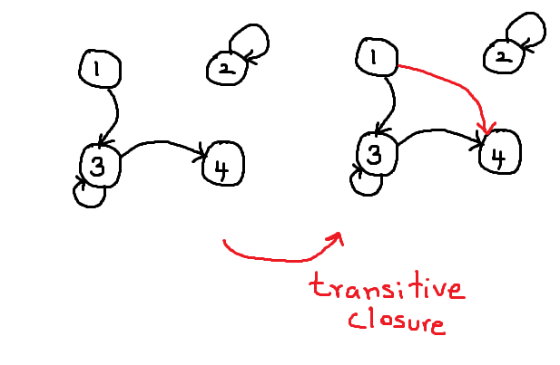
Transitive closure

Slide 9
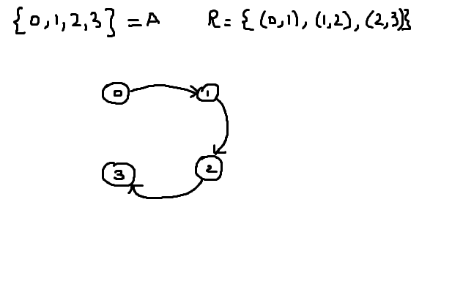
Making a transitive closure of a relation is little complicated and you have to keep applying the algorithm again and again until all transitive ordered pairs are added.
This is not transitive
why ? (0, 2) and ( 1, 3) are missing
Let's add them now

Slide 10
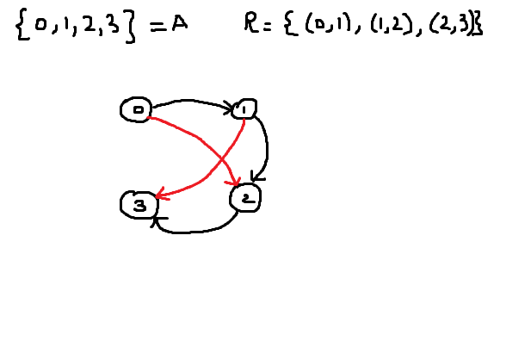
We have added the edges ( 0, 2) and ( 1, 3)
After adding these edges, we see that there is a path from (0, 1) and ( (1, 3)
The new relation is ( 0, 1), ( 1, 2), (2, 3), (0, 2), ( 1, 3)

Slide 11
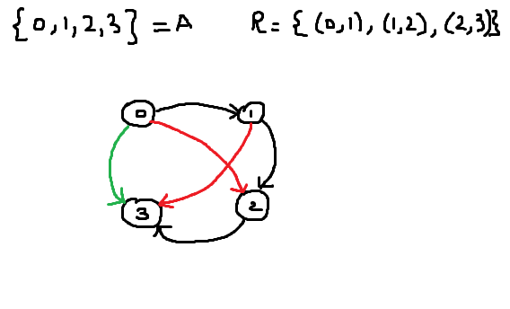
The new relation is ( 0, 1), ( 1, 2), (2, 3), (0, 2), ( 1, 3).
But there is no ( 0, 3) .
We need to add this.

Slide 12
